Slide 1


Lesson 6
In the library
UNIT 1

Slide 2
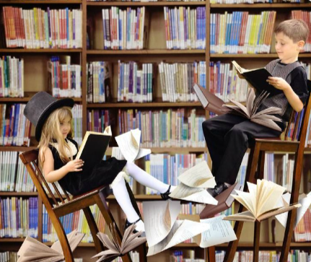
In pairs, think of at least 3 things that you can read.
Present your answers to the class.
reading list – popis djela za lektiru
book reports – lektira
hand in the book reports – predati lektiru
borrow – posuditi od koga
lend – posuditi kome što

Slide 3
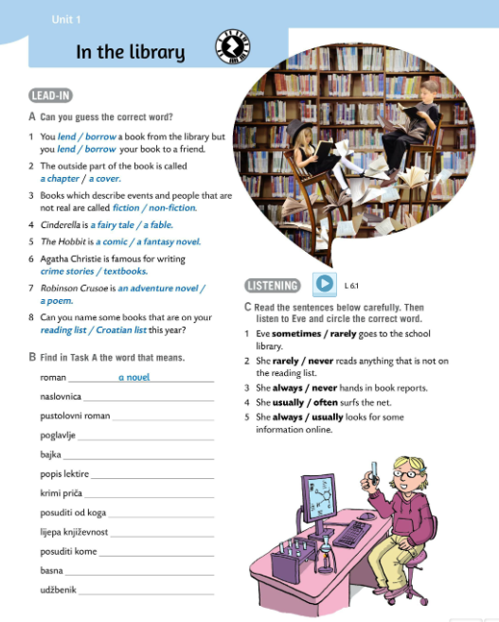
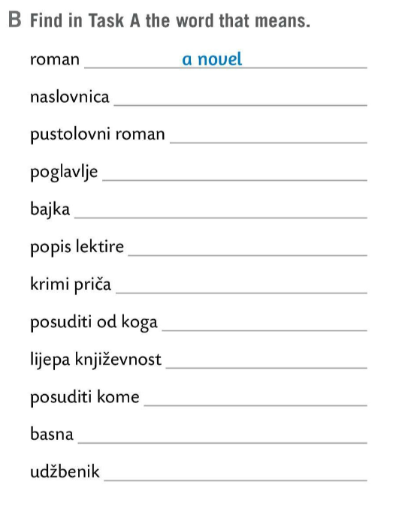
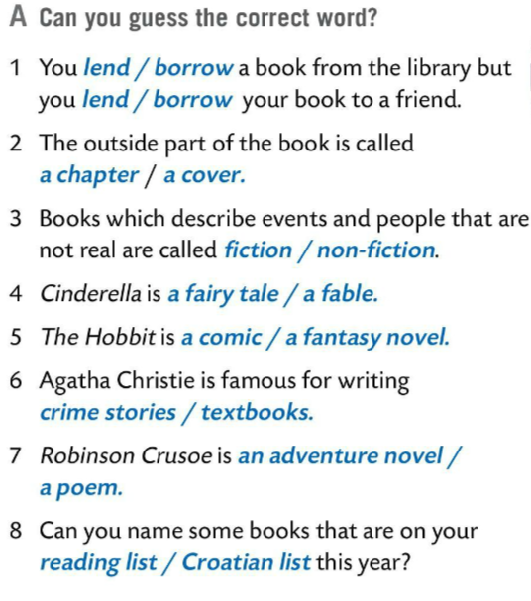
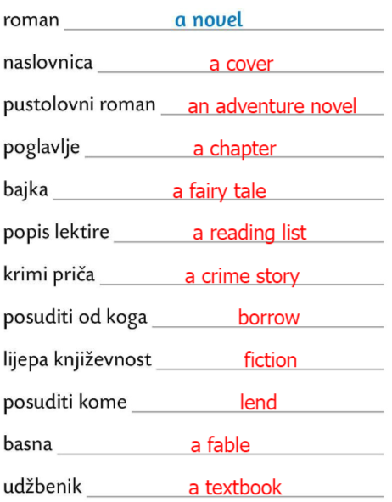

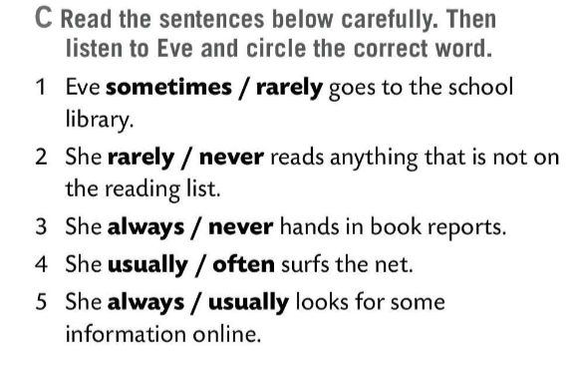

Can you guess the correct word in Task A?
Check.
Find the correct translations in Task B. Use the words in bold from Task A.
Check.
Read the sentences in Task C carefully. Then listen to Eve and circle the correct word.
Listen again and check your answers.

Slide 4
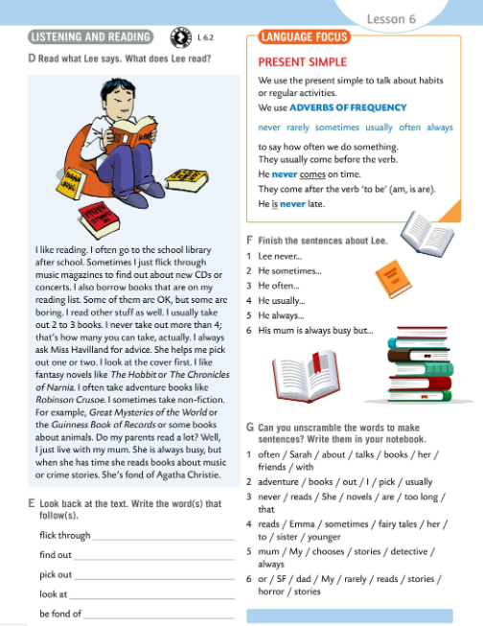
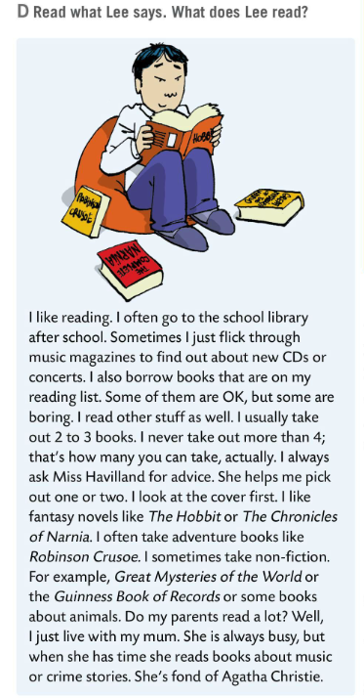
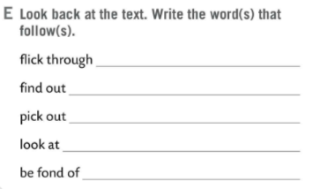
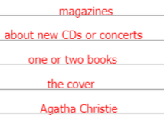
Listen to the recording and then read the text. Find out what Lee reads.
Lee reads music magazines, books that are on his reading list, fantasy novels like The Hobbit or The Chronicles of Narnia, adventure books like Robinson Crusoe, non-fiction like Great Mysteries of the World or the Guinness Book of Records, and some books about animals.
Read the text once again.
Do task E. Write the missing words.
Check.

Slide 5
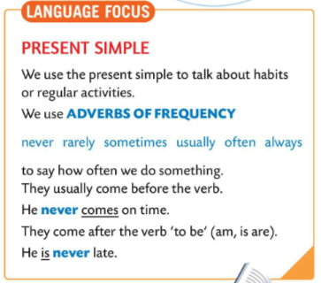
LANGUAGE FOCUS
We use THE PRESENT SIMPLE to talk about habits or regular activities.
Glagolsko vrijeme PRESENT SIMPLE koristimo kada govorimo o navikama ili o redovitim aktivnostima i djelatnostima.
We use ADVERBS OF FREQUENCY to say how often we do something.
never, rarely, sometimes, often, usually always.
Koristimo priloge učestalosti kako bismo izrazili koliko često nešto radimo te koliko često se neka radnja ponavlja. Obično se nalaze ispred glagola.

Slide 6
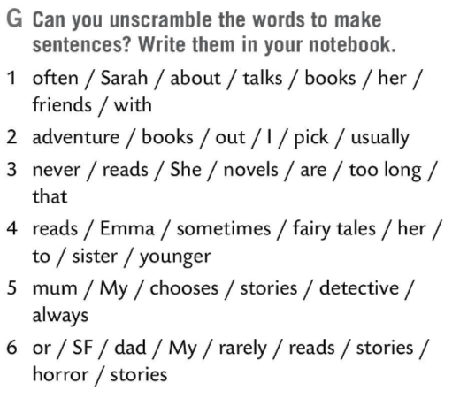
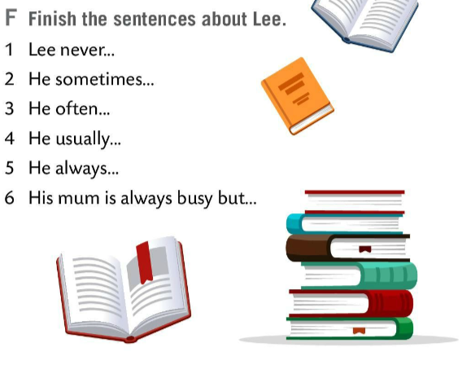
Finish the sentences about Lee in Task F. Underline adverbs of frequency.
Check.
1 Lee never takes out more than 4 books.
2 He sometimes flicks through music magazines.
3 He often goes to the school library.
4 He usually takes out 2 or 3 books.
5 He always asks Miss Havilland for advice.
6 His mum is always busy but when she has time she reads books about music or crime stories.
Unscramble the words to make sentences in Task G?
Check.

Slide 7
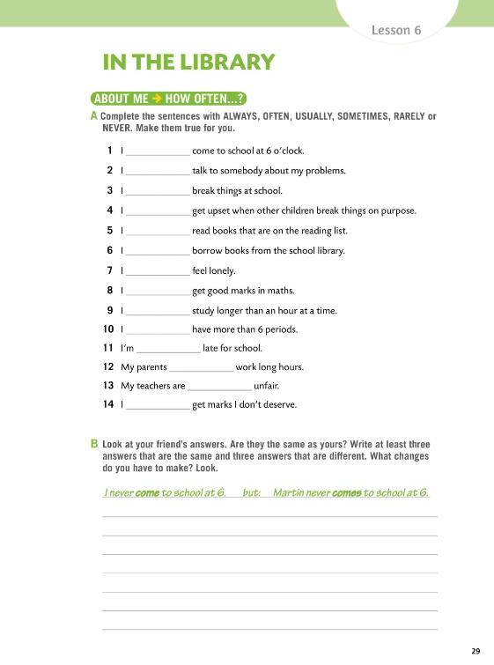

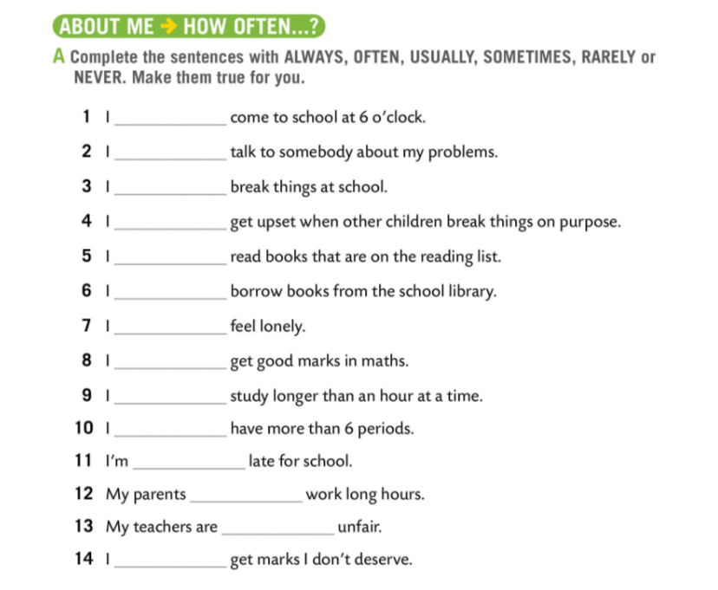
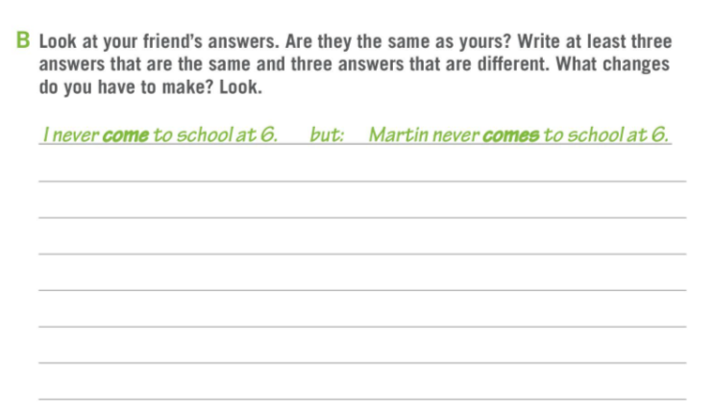
Workbook page 29.
Complete the sentences in Task A with ALWAYS, OFTEN, USUALLY, SOMETIMES, RARELY or NEVER. Make them true for you.
Task B
Compare your answers. Write at least three answers that are the same and three that are different. What changes do you have to make?
Check. Read the answers to the class.

Slide 8
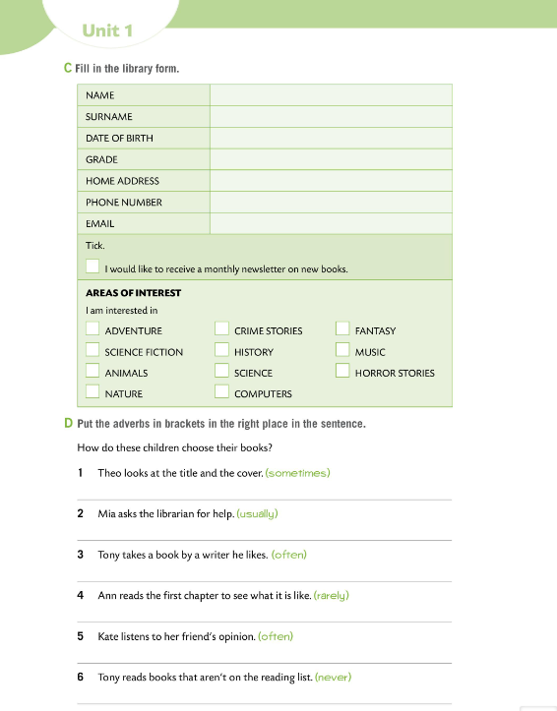
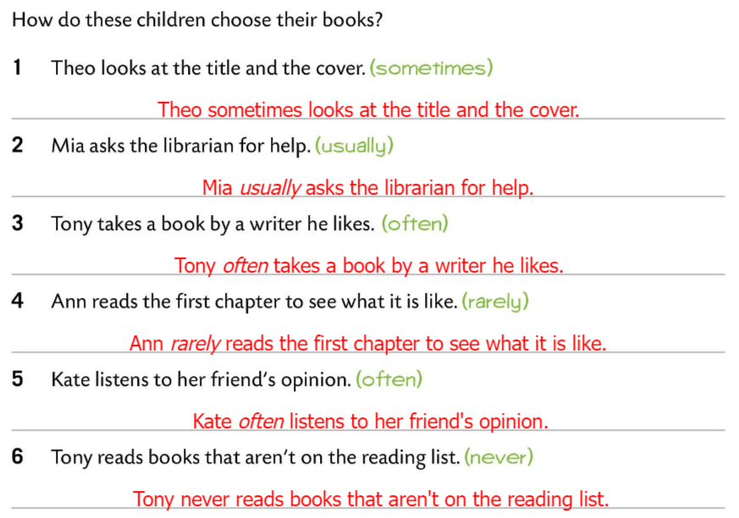
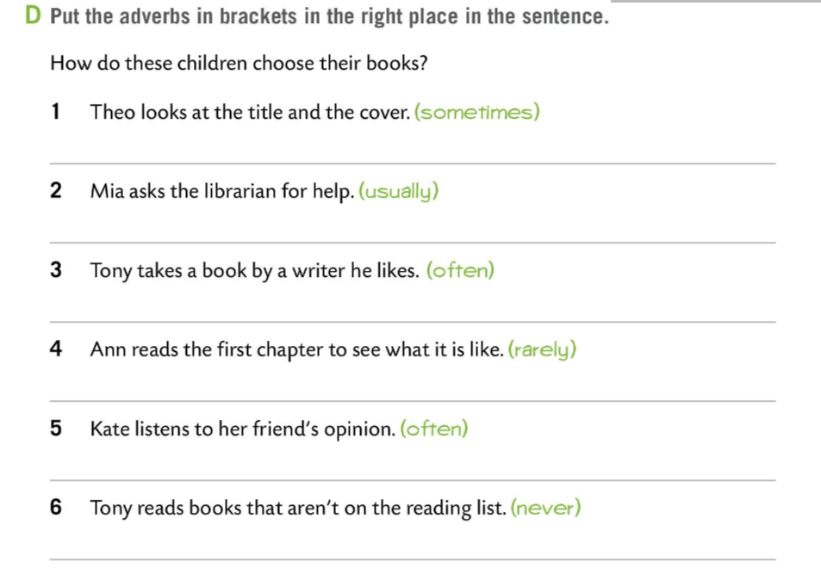
Workbook page 30.
Task D.
Put the adverbs in brackets in the right place.
Check.

Slide 9
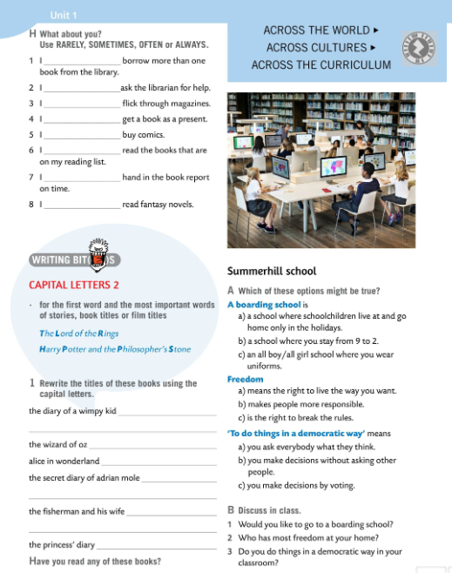
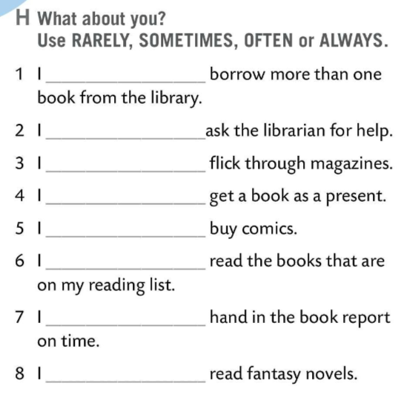

Task H. Use adverbs of frequency to finish the sentences that are true for you.
Share your answers with the class.
WRITING BITES
We use capital letters for the first word and the most important words of stories, book titles or film titles.
Velikim početnim slovom pišemo prvu riječ i najvažnije riječi u nazivima priča, knjiga i filmova.
The Lord of the Rings
Harry Potter and the Philosopher’s Stone

Slide 10
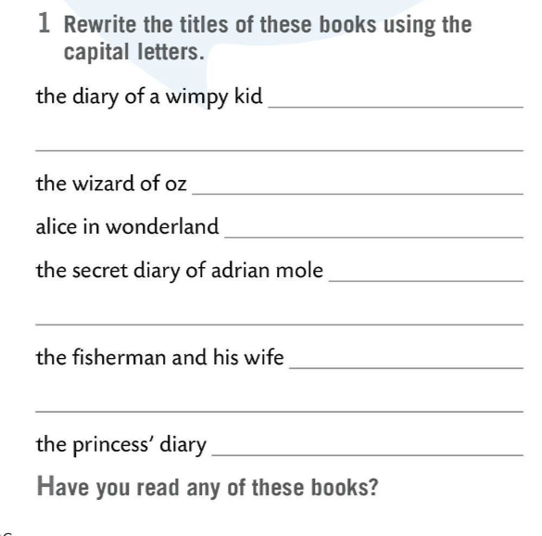
Task 1.
Rewrite the book titles using capital letters.
The Diary of a Wimpy Kid
Check.
The Wizard of Oz
Alice in Wonderland
Have you read any of these books? Which ones?
The Secret Diary of Adrian Mole
The Fisherman and his Wife
The Princess’ Diary

Slide 11
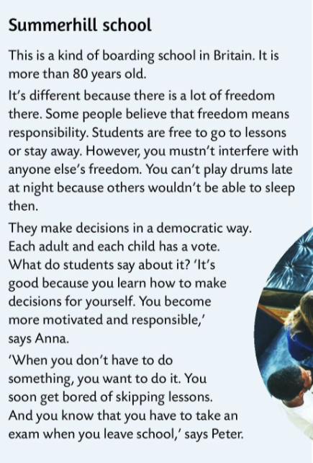
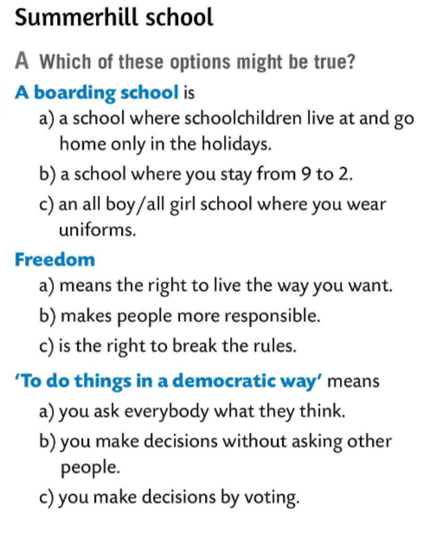
Read the questions under the Summerhill school heading.
Which of the questions in Task A might be true? Circle.
Read the text.
Listen and check your answers.

Slide 12
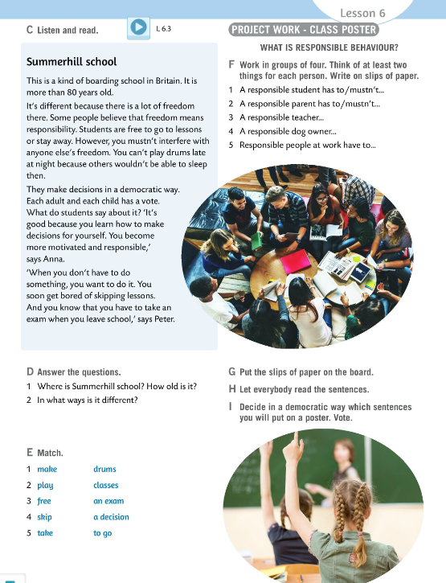
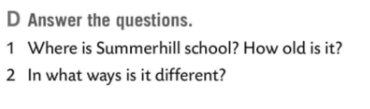
Listen to the text once again.
Answer the questions in Task D.
Check.
1 Summerhill is a boarding school in Britain. It is more than 80 years old.
2 It’s different because there is a lot of freedom. Students are free to go to lessons or stay away. They make decisions in a democratic way. They make decisions for themselves and become more responsible.

Slide 13
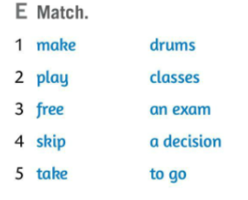
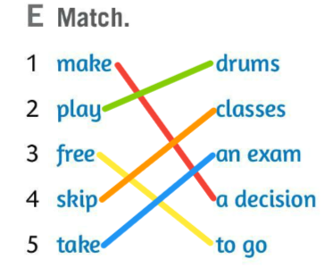
Match expressions in Task E.
Check and translate.
make a decision – donijeti odluku
play drums – svirati bubnjeve
free to go – slobodno otići
skip classes – markirati s nastave
take an exam – polagati ispit
Play a Summerhill quiz in two teams! https://wordwall.net/play/621/194/761

Slide 14
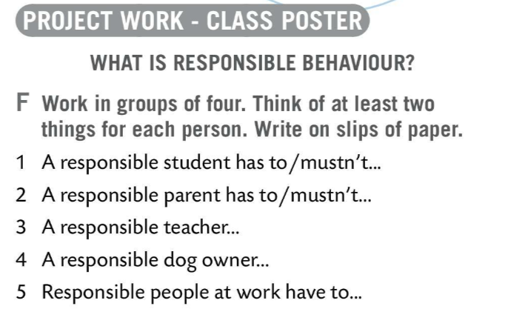
Make a class project. Work in groups.
What is responsible behaviour? Work in groups of four and think of at least two things for each person in Task F.
Decide in a democratic way which sentences you will put on a poster. Vote!

Slide 15
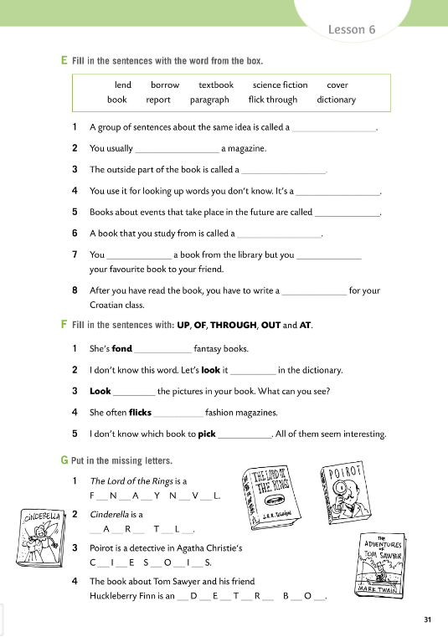
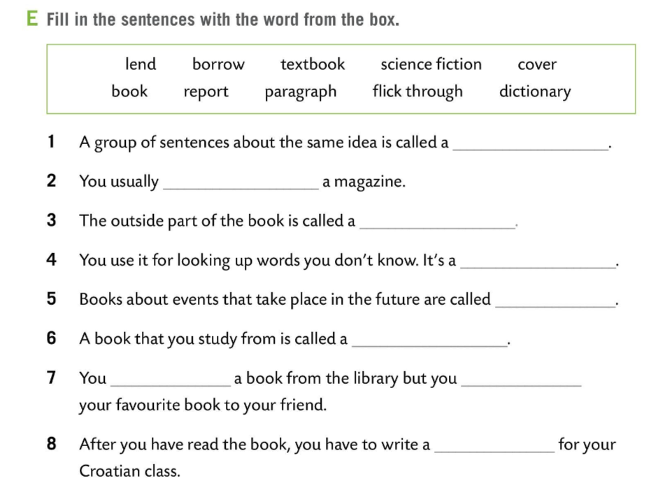
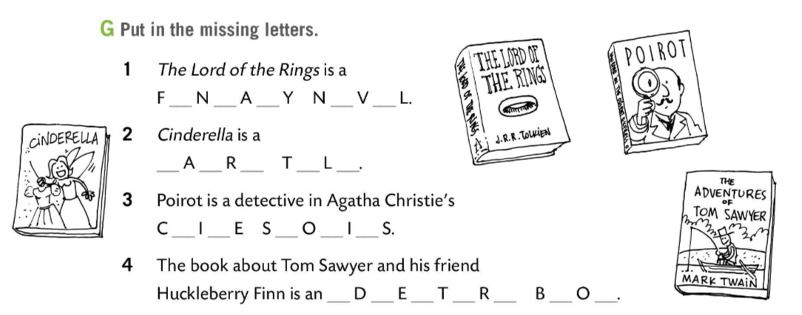
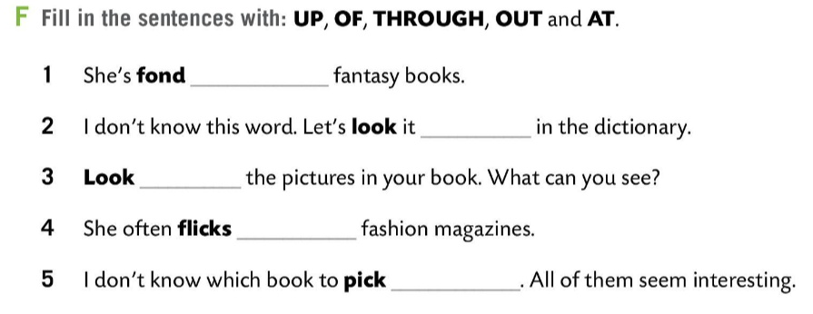
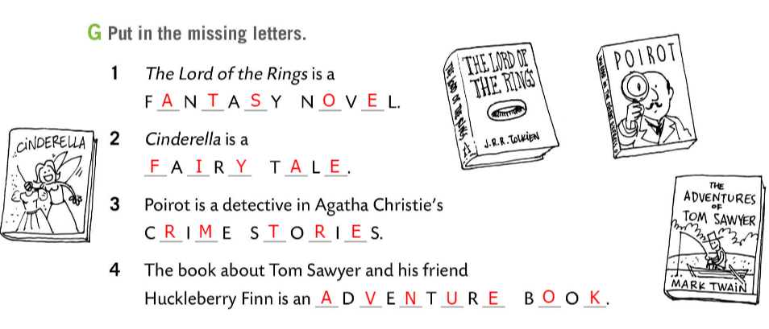
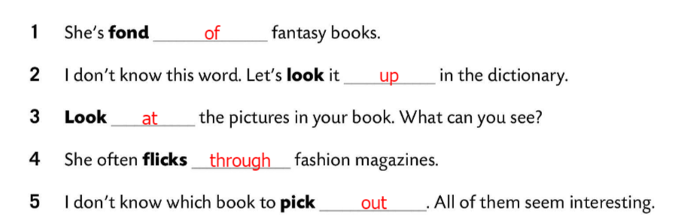
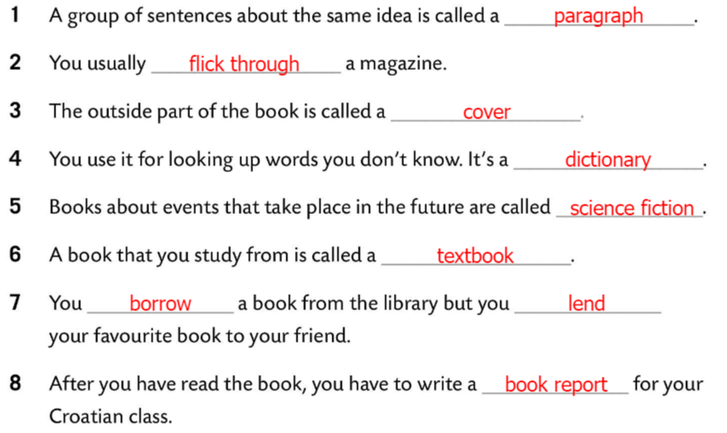
Workbook page 31.
Fill in the sentences with the words in Task E.
Check.
Fill in the sentences with UP, OF, THROUGH, OUT and AT in Task F.
Check.
Put in the missing letters in Task G.
Check.

Slide 16
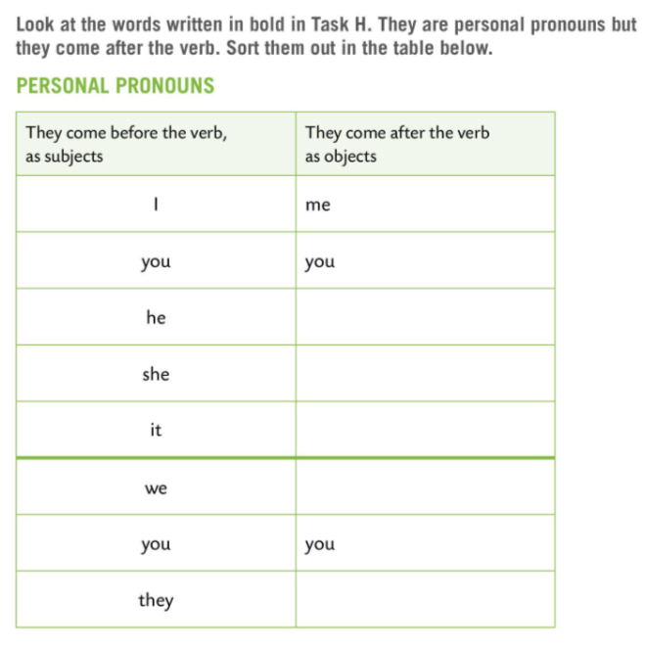
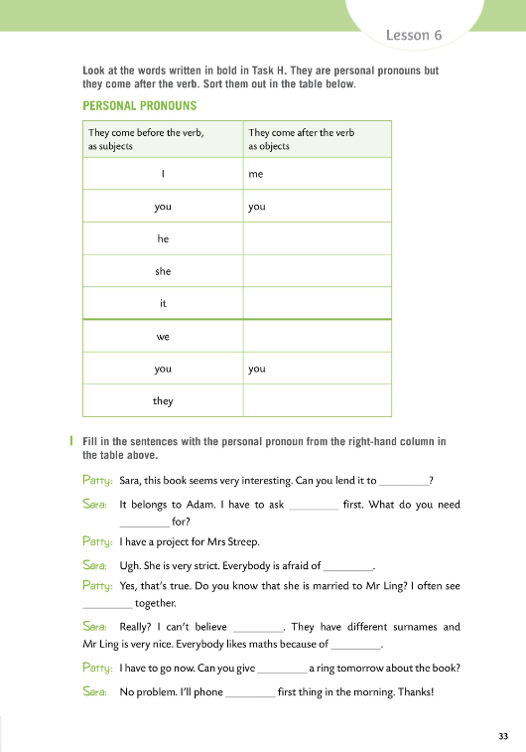
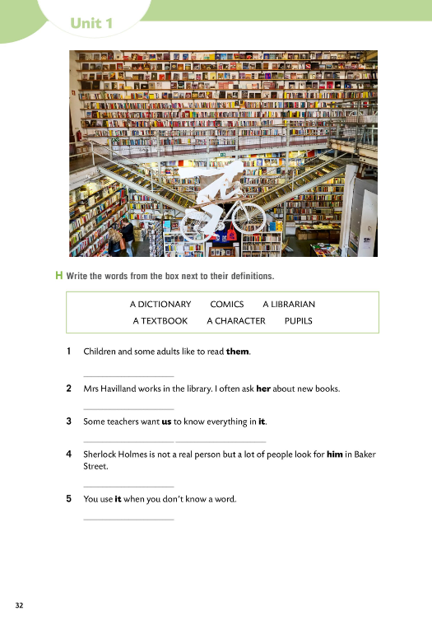
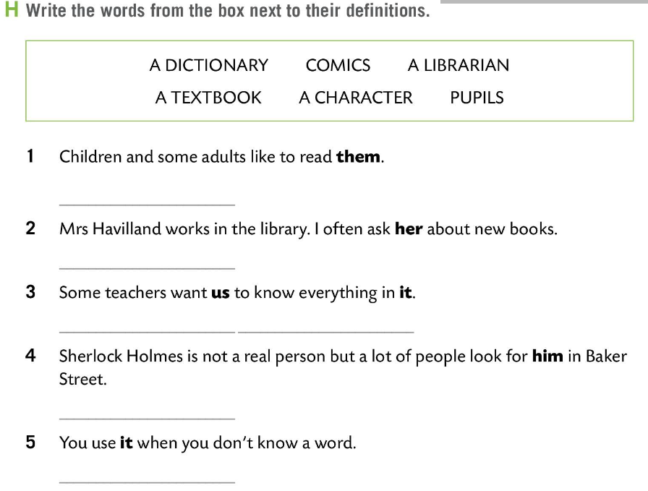
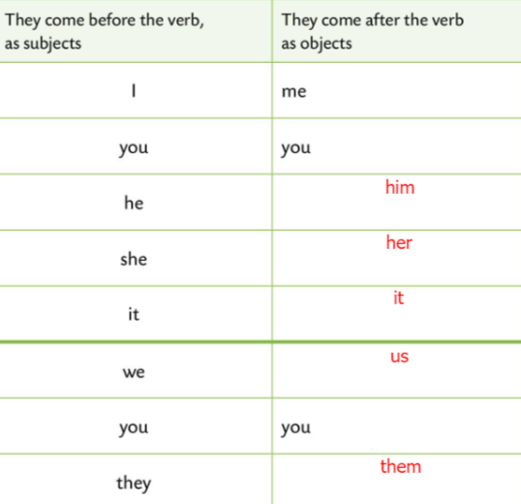
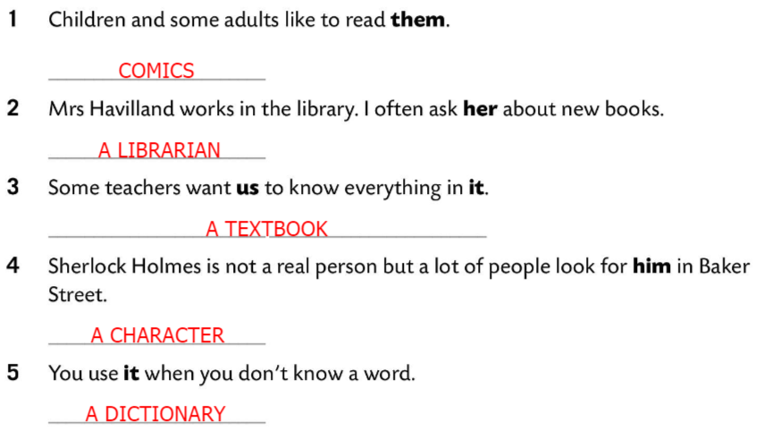
Workbook pages 32 and 33 .
Write the words from the box next to their definitions.
Check.
personal pronoun (osobna zamjenica), može u rečenici biti subjekt ili objekt
Sort them out in the table below.
Check.

Slide 17
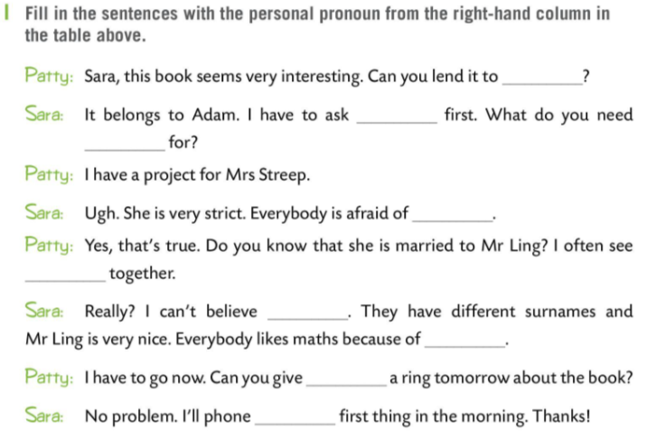
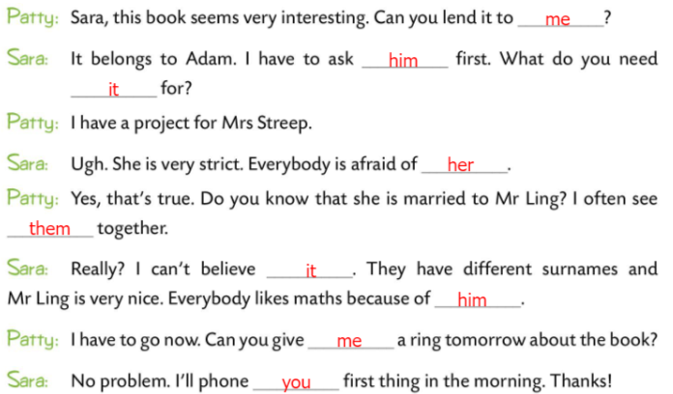
Workbook page 33 .
Fill in the sentences in Task I with the correct personal pronoun.
Check.

